Slide 1
Elevate Your Lifestyle with my Mobile app
MOODIFY APP
NAME: ADITYASINH RANA
REG: 22BAI1423

Slide 2
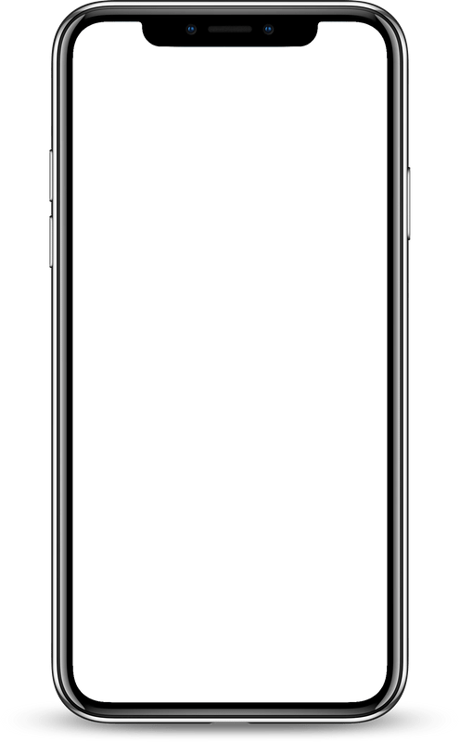

A Simple, Yet
Effective Way to Be More Productive.
Moodify is a mobile app designed to help users track their mood and recommend activities to improve mental well-being.
I have been planning this project for a very long time, and this course has given me this opportunity. I've been working on this project for more than 15 days now.
Simple, intuitive, and personalized.
moodify

Slide 3

Key Features
Mood Tracking: Log your mood daily with ease.
Activity Suggestions: Personalized activity recommendations like Reading, Meditation, Workout, Music, etc.
Clean UI: Minimalistic design using Jetpack Compose.
online Mode: Works with backend dependency for smooth user experience.(to be worked)

Slide 4
Architecture Overview
Clean and Modular Architecture:
The app follows a modular approach separating concerns into distinct layers — Presentation, Domain, and Data — to keep the codebase clean, maintainable, and scalable.
Presentation Layer:
Built using Jetpack Compose for declarative UI.
Handles UI components, navigation, and user interactions.
Uses ViewModels to manage UI-related data and lifecycle-aware state management.
Domain Layer:
Defines business logic and interfaces, such as the ActivityRepository.
Acts as a mediator between UI and Data layers, enabling easy testing and flexibility.
Data Layer:
Provides data to the app, primarily from local hardcoded sources for offline-first experience.
Originally planned with Retrofit and remote APIs but simplified to local data sources for faster and more reliable usage.
Responsible for data mapping (e.g., DTOs to domain models).
Coroutines and Kotlin Flow:
Used for asynchronous programming and reactive data streams.
Ensures smooth UI updates without blocking the main thread.

Slide 5
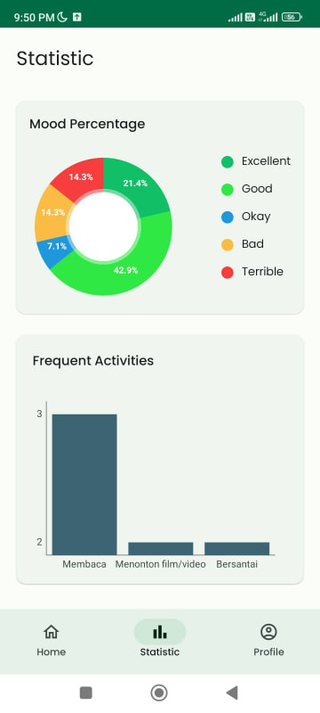
Technical Highlights
Kotlin Coroutines and Flow for asynchronous data handling.
Splash screen with installSplashScreen() for smooth app startup.
Navigation component with bottom navigation for Home, Statistics, and Profile.

Slide 6
Challenges Faced
Transitioning from backend API calls to local data due to API complexity.
Managing package renaming throughout the project.
Packages installing problems.
Ensuring Firebase integration without backend dependencies.

Slide 7
Next Steps
Implement local database for mood history.
Add personalized recommendations based on mood patterns.
Enhance UI with animations and user feedback.

Slide 8
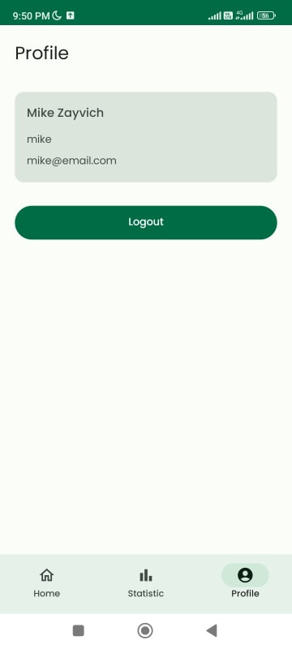
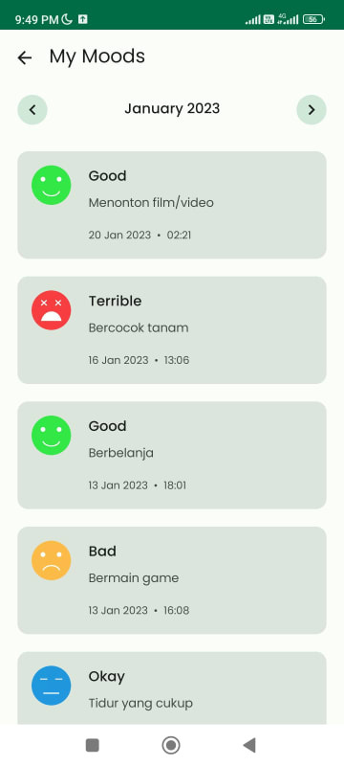
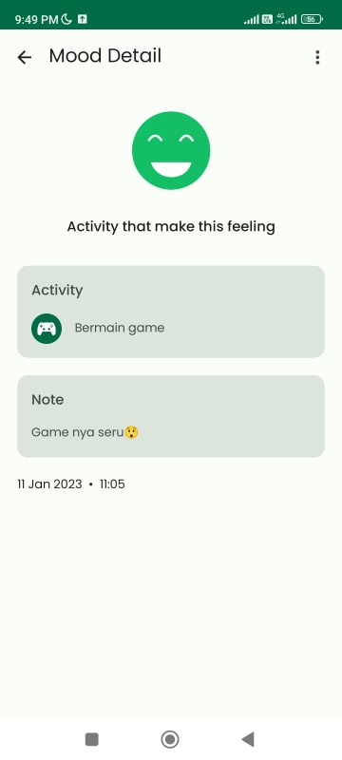
Screen shots

Slide 9
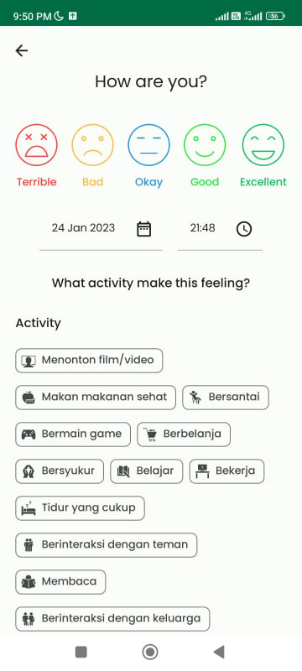
Screen shots

Slide 10
Thank You
+123-456-7890
123 ANYWHERE ST., ANY CITY
REALLYGREATSITE.COM

